Slide 1
Flight agent system – phase 2
Carnegie Mellon

Slide 2






Security Team3 – Security Fighters
Carnegie Mellon
Dan
Sanju
DK
Jo
Baek
Hong

Slide 3
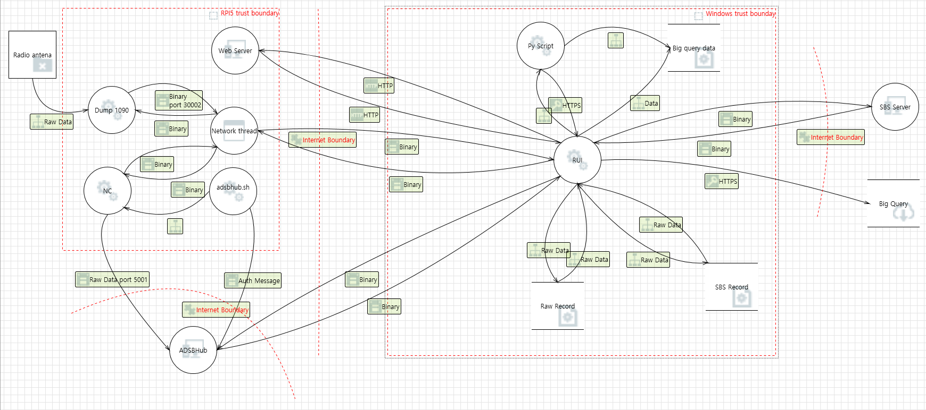
Attack Surfaces : Overview
5
2
1
6
3
4

Slide 4
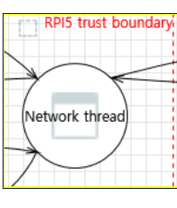
Attack Surfaces : Case 1
RPI5
Security Flaws
Missing firewall rules / Rate limiting
No network Intrusion Detection System
No cloud-Based DDoS Protection
Threat
Denial of service
Attack vector
SYNC flood

Slide 5
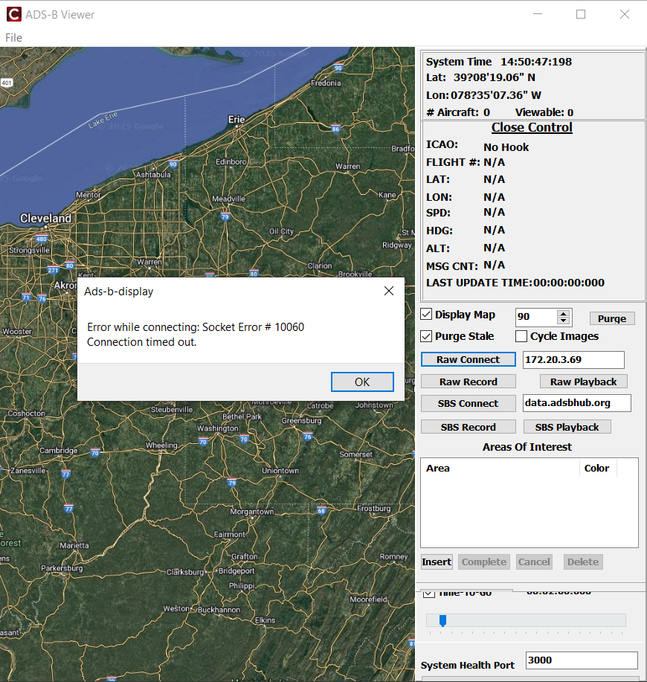
Attack Scenario #AS-1 : Denial of service
Precondition
1. Server is running on RPI5 device waiting for connection over 30002 port
Tool used
hping3
Execution steps
Launch sync flood attack
sudo hping3 -d 120 -S -w 64 -p 30002 --flood --rand-source 172.20.3.156
2. Connect to server from RUI using Raw connect
Conclusion
The SYN flood successfully achieved a denial of service by exhausting available connections and causing timeouts.

Slide 6
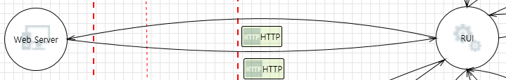
Attack Surfaces : Case 2
Web Server (RPi5) <-> RUI
Security Flaws :
Unencrypted data transmission
Lack of authentication
No integrity check
Threat :
Information Disclosure, Tampering
Attack Vector :
Man in the middle attack using TCP proxy

Slide 7
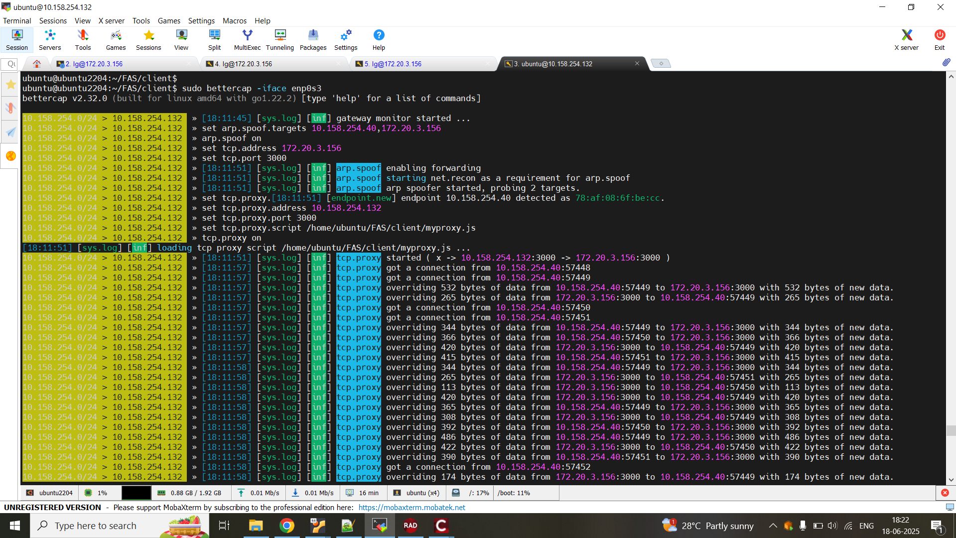
Attack Scenario #AS-2 : Man in the middle attack
Precondition
Web server is running on RPI5 device waiting for connection over 3000 port
Server, client and MITM device on same network
Bettercap tool is installed on ubuntu VM
Tool used
bettercap
Steps to execute attack
1. Start bettercap tool on ubuntu VM
2. Connect to server using Raw connect
3. Click SYSTEM HEALTH button on RUI

Slide 8
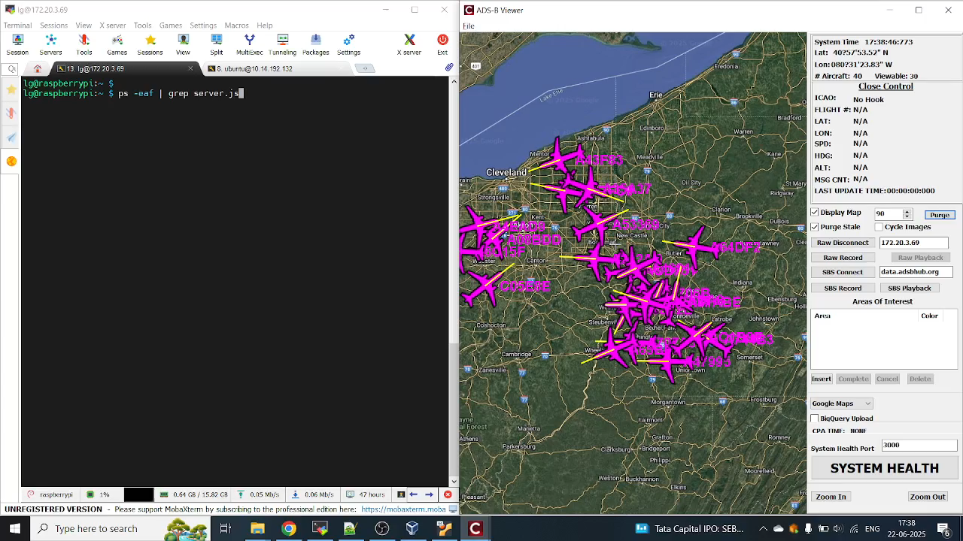
Result Video

Slide 9
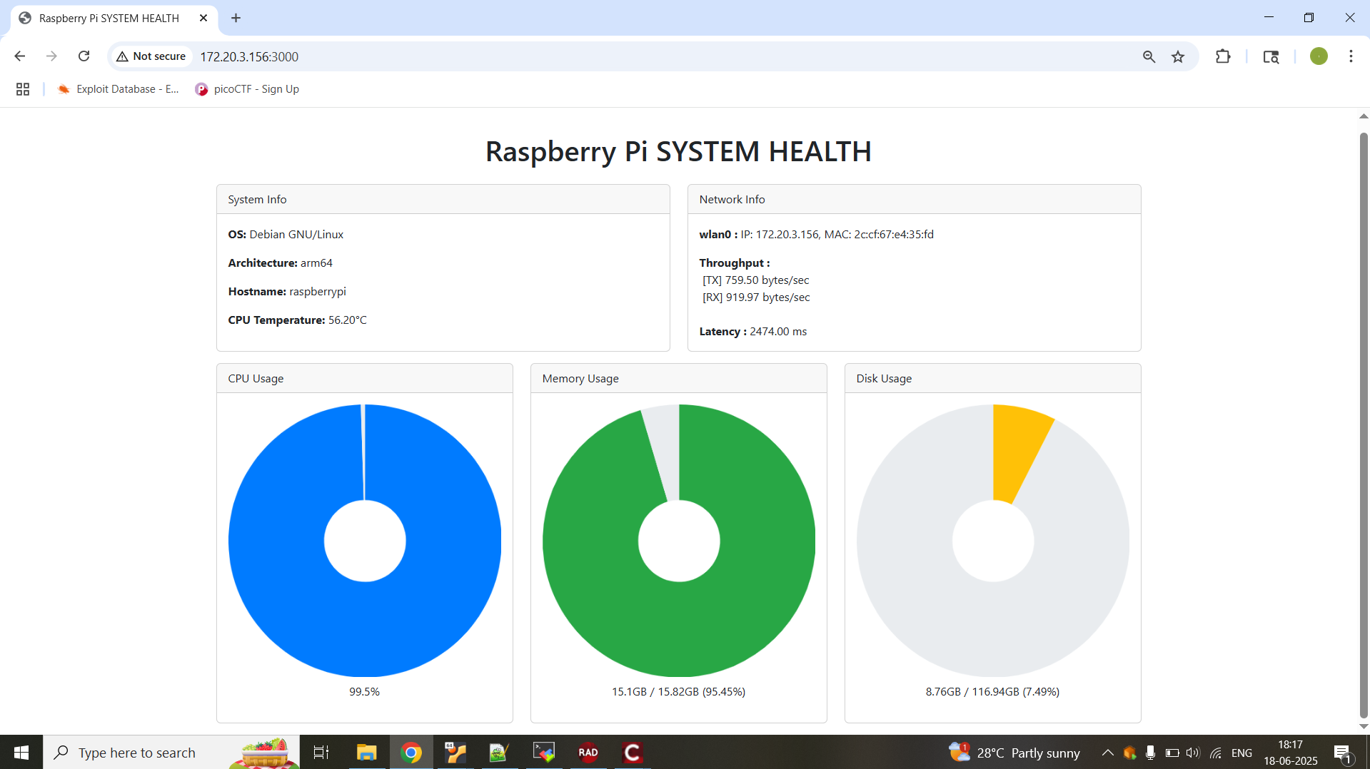
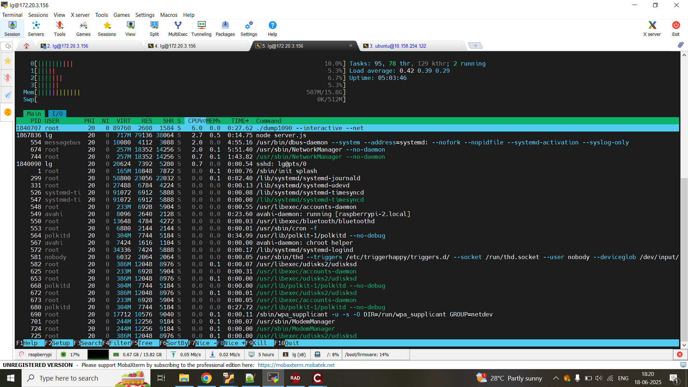
Conclusion
Unencrypted data on network can be intercepted and tampered with man in the middle attack

Slide 10
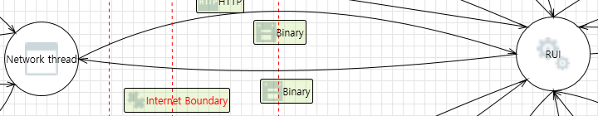
Attack Surfaces : Case 3
RPI5 <-> RUI
Security Flaws
Unencrypted data transmission
Lack of Mutual Authentication for connection establishment
No integrity check for the data
Threat
Information Disclosure, Tampering
Attack Vector
TCP session hijacking

Slide 11
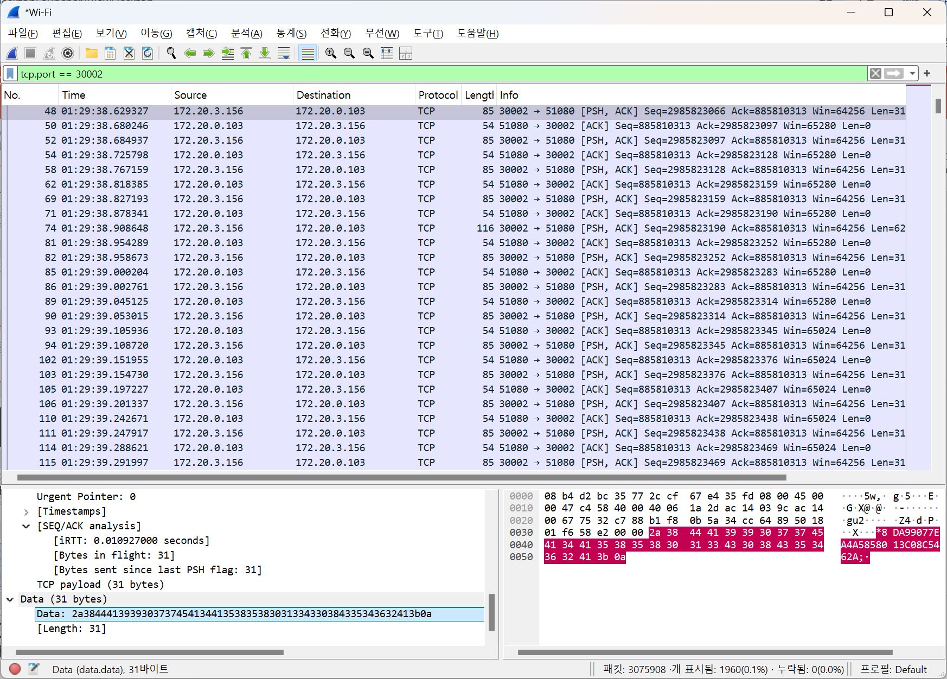

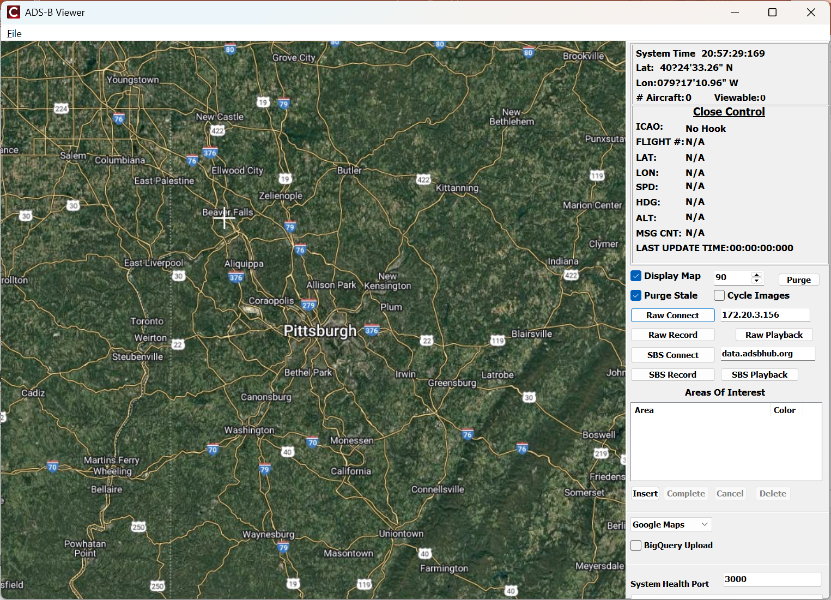
Attack Scenario #AS-3 : TCP Session Hijacking
Precondition :
Server client MITM are in same network
Data is captured using Wireshark between RPI & RUI
Modify the packet to create fake packets
Attack :
Start local server on Ubuntu for reading data from stored pcap file
Launch bettercap tool and set configurations to reroute IP
Initiate connection from client
Initiate connection from the client
Wireshark -
capture and modify
3-way
Handshake
Send
Fake Packets
Fake Server
RUI

Slide 12
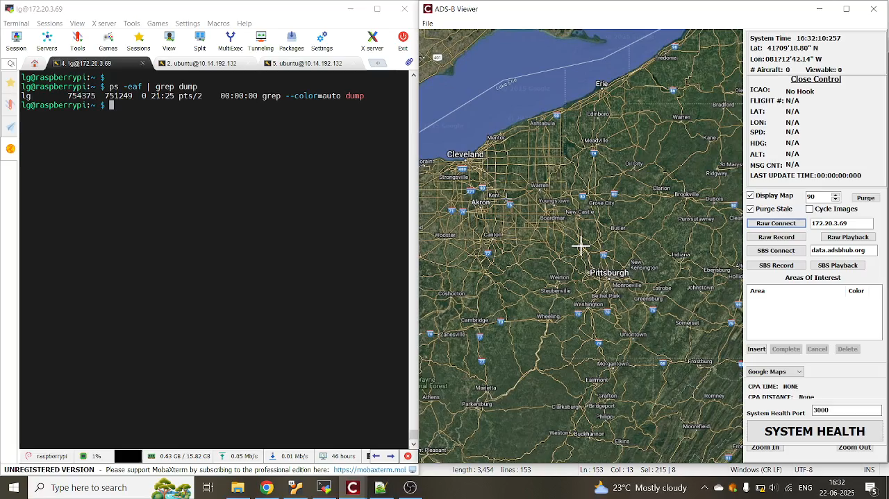
Result Video

Slide 13
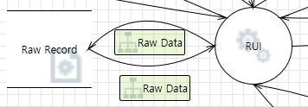
Attack Surfaces : Case 4
Information Disclosure and DoS via Raw Data Tampering on Record data.
Threat
Dos, Information Disclosure, Tampering
Security Flaws
String Manipulation Errors
- Unsafe String copy logic used.
Plain Record text
- Plaintext exposure of recording data
Attack Vector
Information Disclosure
- Manipulation of plaintext of unencrypted records
Denial of Service(DoS)
- Incorrect string manipulation can cause a buffer overflow, resulting in a DoS attack.
Notes:
Attack Surface Case 4 is between RUI and Raw Record
The RUI Application saves the RAW data in the local storage.
This data is stored in plaintext and has the threat of Information Disclosure.
The stored data is used as input data in the RUI Application
Security Flaws are unsafe string copy and attack vector is buffer overflow resulting in Dos attack.

Slide 14
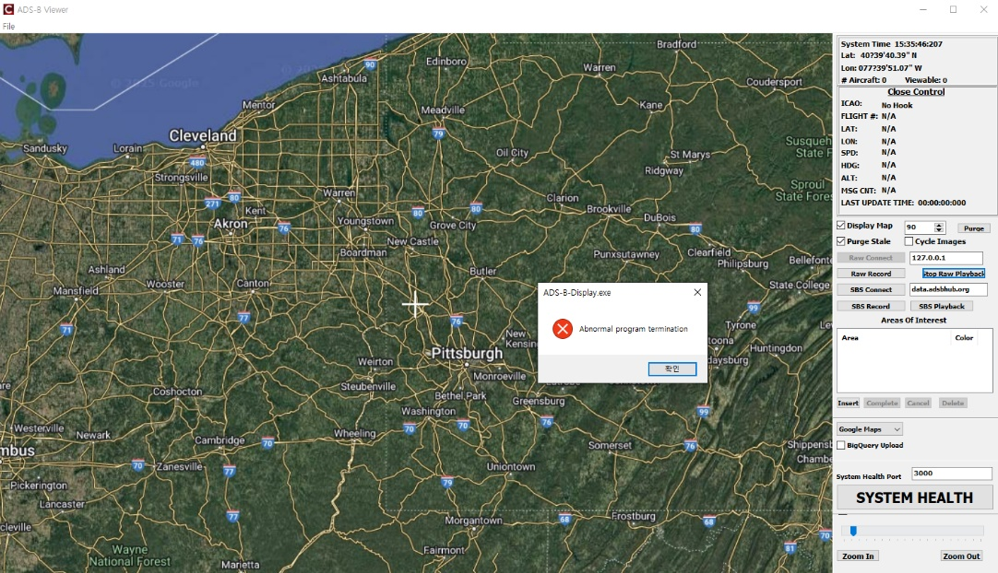
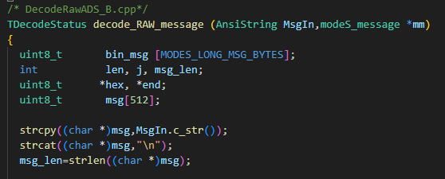
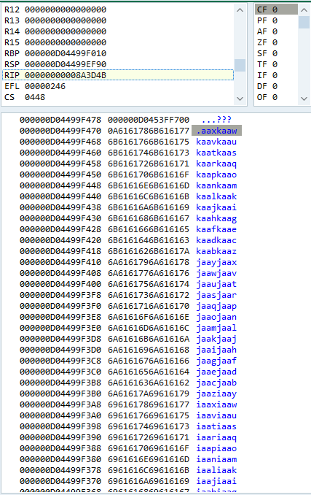
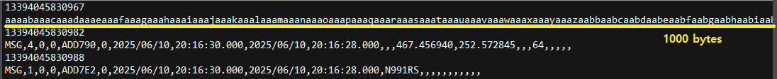
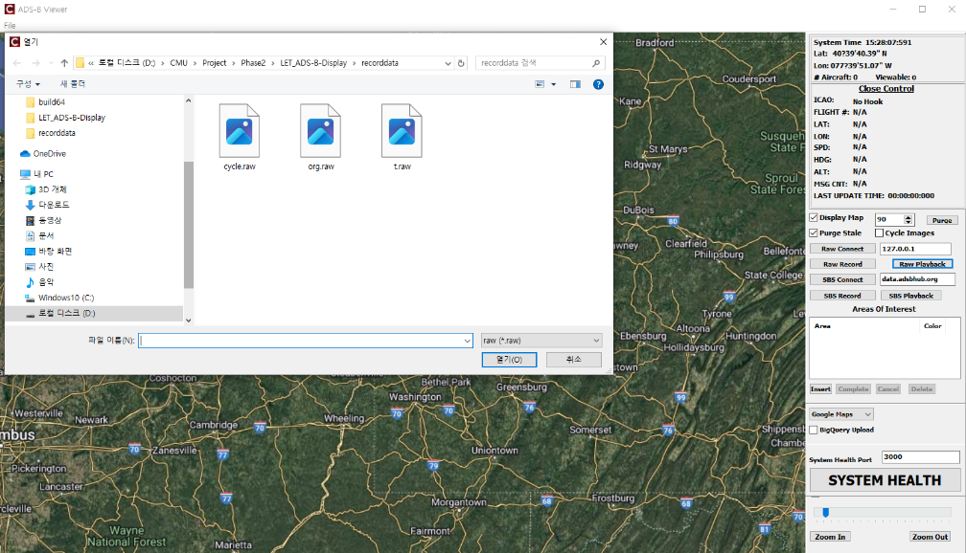
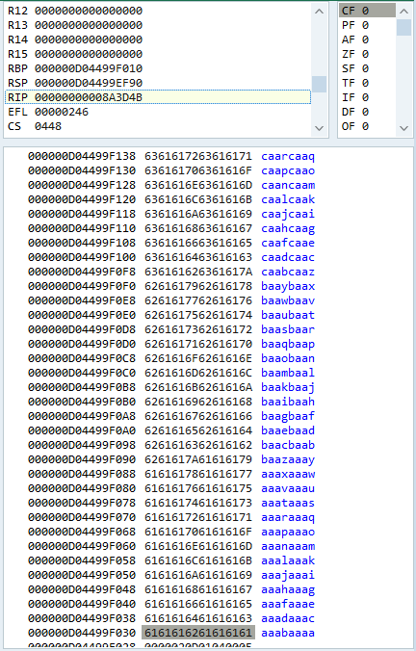
Attack Scenario #AS-4 : Data tampering and play tampered data
Target : Recorded data from RUI
Precondition :
Step 1. Modify record data
Step 2. Playback tampered data
< Application is terminated >
< Incorrect string manipulation>
< Manipulate flight info >
. . .
< Overwritten stack data >
< Playback tampered data >
Notes:
Attack Scenario number 4 is Data tampering.
The msg variable was declared as unsigned integer, array of 512 bytes.
So if we input record data 1000 bytes, buffer overflow occurs and the application crashes.

Slide 15
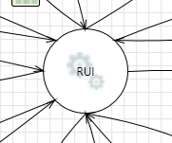
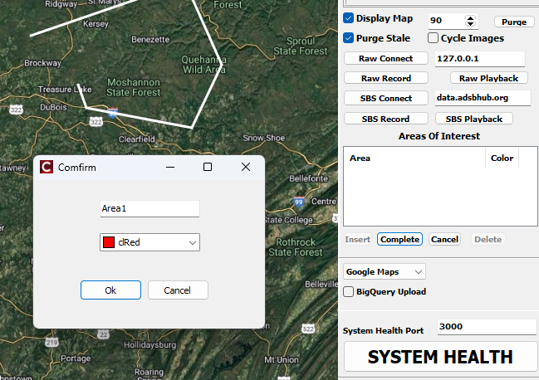
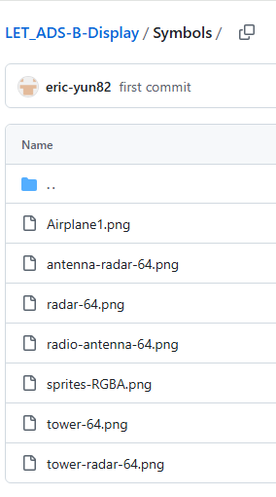
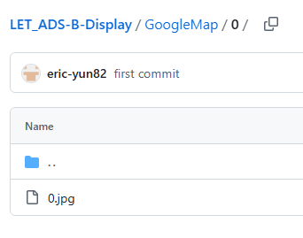
Attack Surfaces : Case 6
RUI (GUI)
Security Flaws
Invalid input validation
Insecure code generation
Attack Vector
Command-line injection
Dos with invalid/malicious inputs
Texts that users can input
Symbol png images
Map jpg images
Notes:
Next, Attack Surface Case 6 is about RUI.
SDET Team 3 newly implemented System Health UI, and RUI includes this.
Also, through our mentor Dan's advice, we found several input problems that could not be found in DFD.
They are user input textboxes, symbol png images, and map jpeg images.
Security Flaws are Invalid input validation and Attack vector is command line injection and DOS

Slide 16
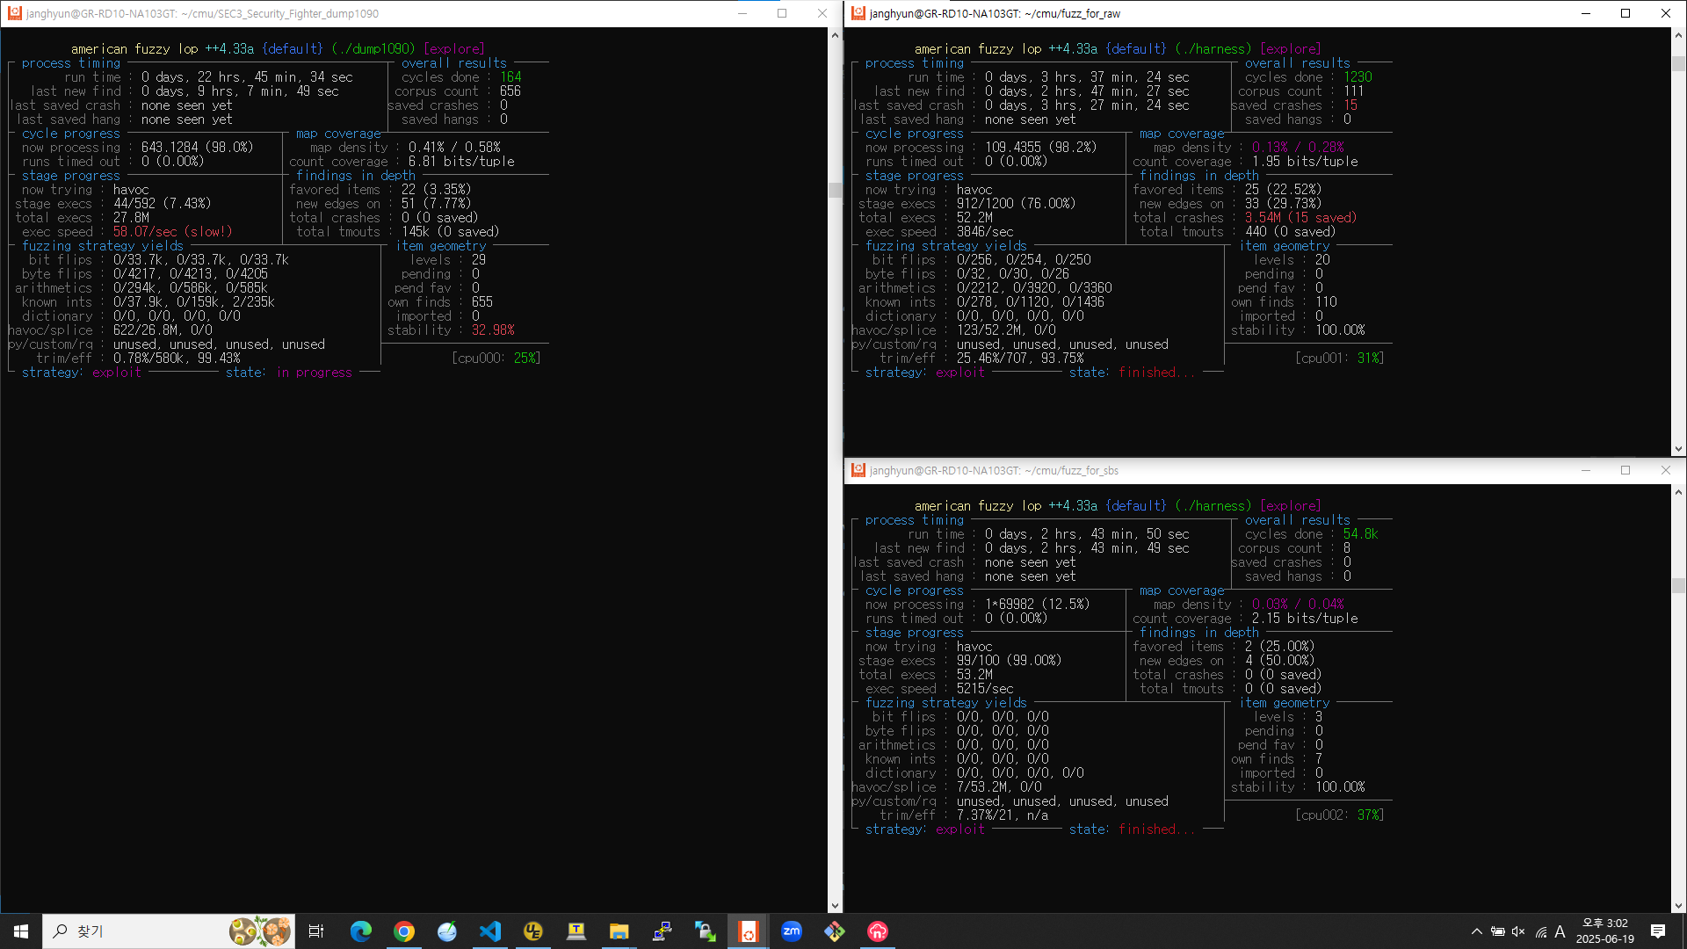
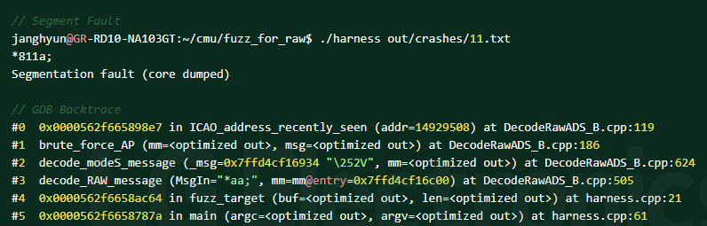
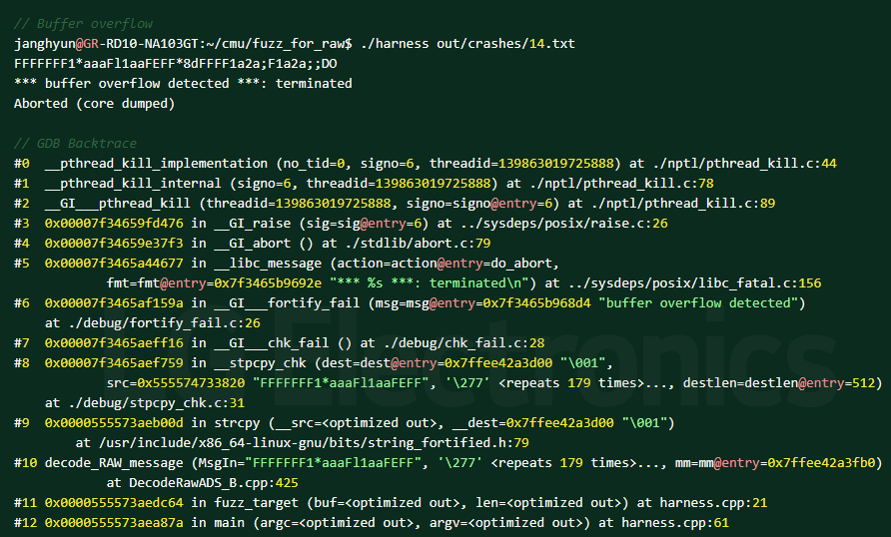
Fuzz test for RUI Decode logic
Fuzz for Decode Raw Data
Case 1~14 : unexpected input character value causes crash
-> No issues due to exception handling in Window RUI App.
15 cases
Case 15 : long input data causes crash
-> Actual flaw of “Decode Raw Data”
Fuzz for Decode SBS Data
Notes:
In order to run a fuzz test, we ported to Linux the Decode functions of the RUI program and performed a fuzz test.
In the case of SBS Data Decode, no crash occurred.
In the case of Raw Data Decode, we found 15 crashes.
14 crash exceptions were handled by Try and catch, so no actual problems occurred.
However, Case 15, long input data caused crash due to Buffer overflow and exception was not handled.

Slide 17
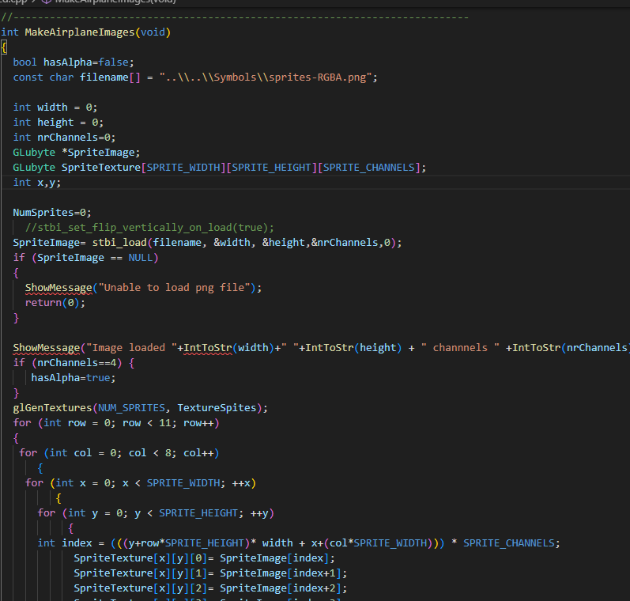
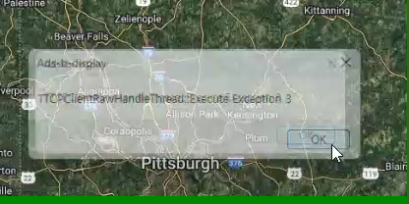
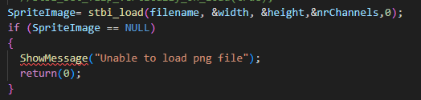
Attack Surfaces : Case 6
Attack Scenario #AS-5
Target : DoS (Crashes the RUI system) with invalid inputs
Precondition : Create crafted PNG file.
Step 1. Overwrite the sprites-RGBA.png in Symbols directory.
Step 2. Run the RUI (Exception occurred once in here).
Step 3. Check the cycle Image and Run the Raw playback (or SBS Playback).
Consequence : System goes unavailable with continuous exception pop-up. [VN-11]
Crafted PNG
The PNG structure (IHDR, IDAT, IEND) is valid, but mismatch between its declared dimensions and the actual pixel count.
DoS : Infinite Error pop-up
Insecure code : Insufficient input data validation
Notes:
Attack Scenario #5 is DoS with invalid inputs
There was only stbi_load function was handling error.
So, we created a PNG file with specific pixels applied that can pass this function and replaced it.
After applying this, when RUI is executed, an infinite number of error pop-ups occurred.
Since RUI cannot be used normally, we think that it has reached a DoS state.

Slide 18
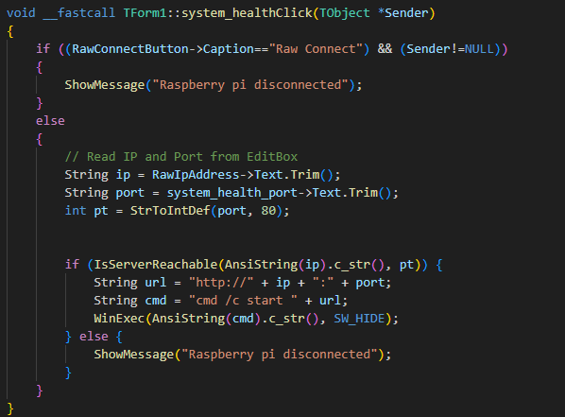
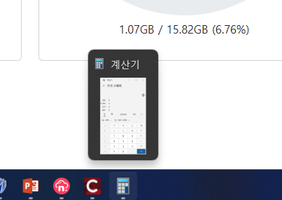
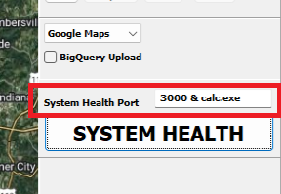
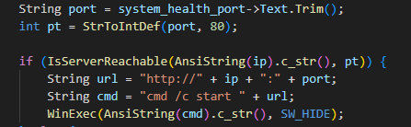
Attack Surfaces : Case 6
Attack Scenario #AS-6
Target : Command injection & Execute arbitrary command
Precondition : Attacker has access to the RUI on the Windows PC.
Step 1. Establish MITM Position for 80 port.
Step 2. Redirect the 80 port to fake server.
Step 3. In the "Port" textbox, input the malicious command (link with ‘&’)
Step 4. Click the ”SYSTEM HEALTH” button.
Consequence : The attacker successfully executes an arbitrary command
Calculator
Insecure code :
- WinExec()
- StrToIntDef : Default port
No input validation
Executes arbitrary command
Notes:
Attack Scenario #6 is Command Injection
When SDET team 3 newly implemented the system health check code, they used the dangerous windows-api WinExec function. We are going to use this function.
They receive the port number in a textbox and convert this value to StrToInt. If there is a non-number character, it fails, StrToInt returns the default value as 80.
Then, they check if the returned 80 port is reachable or not.
So we redirected HTTP traffic (port 80) to the fake server, and the server is now running.
So 80 port is reachable, So we can do command injection.

Slide 19
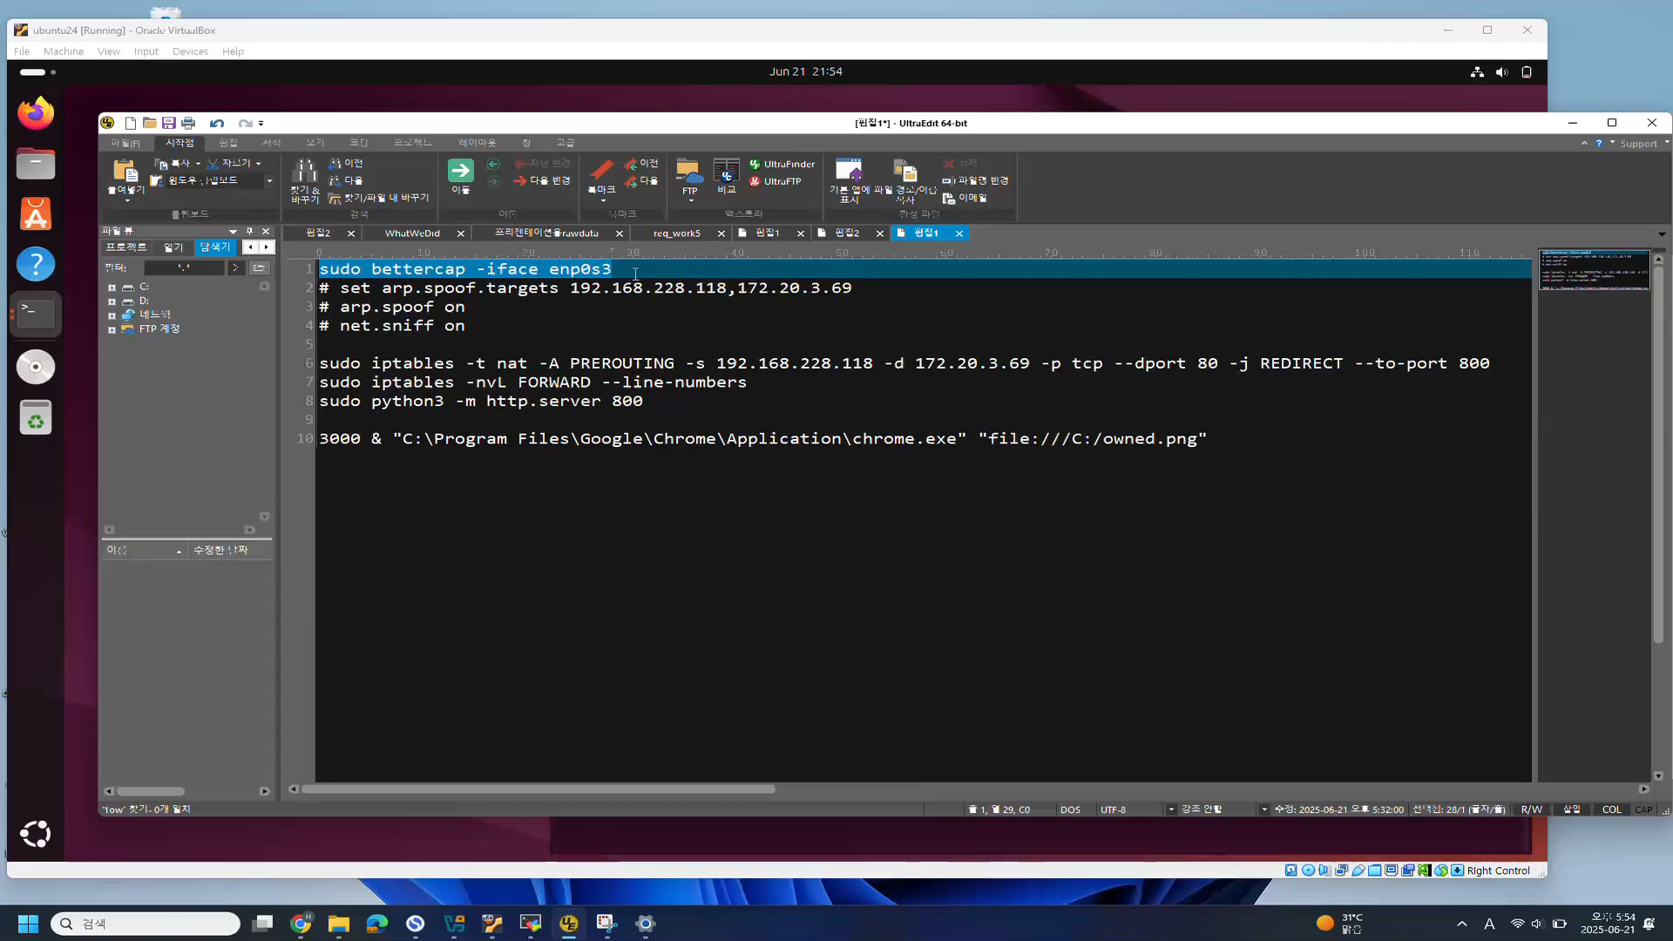
Result Video
Notes:
Let’s see the Result Video, it’s our highlight.
So we showed owned.png in Chrome browser.
And we can execute calculator also.

Slide 20
Results and Analysis
ID | Summary | Location | Consequences / Impact | Type | Proof of Concept | Slide
AS-1 | Attack PI network thread | TCP/IP stack and connection logic of “adsbhub” network thread | Failure of the server connection from client | Denial of Service | Sync flood attack - hping3 -d 120 -S -w 64 -p 30002 --flood --rand-source 172.20.3.156 | 5
AS-2 | Tampering server health status | TCP network | Tampering server status(health) | Data Tampering / Spoofing/Repudiation | MITM attack - bettercap -iface enp0s3 | 7
AS-3 | TCP Session Hijacking and send fake data to client | TCP network | TCP Session Hijacking - send fake packet to client | Data Tampering / Spoofing/Repudiation | TCP Session Hijacking - redirect port and replay captured data using WireShark. | 11
AS-4 | Tamper recorded data and make DoS. | RUI DecodeRawADS_B.cpp decode_RAW_message() Line 420 (strcpy) | RUI crash by buffer overflow | Denial of Service / Information Disclosure / Data Tampering | Tamper raw record data of flightinfo(more than 512 byte) and and playback. | 14
AS-5 | DoS attack using tampered PNG | RUI ntds2d.cpp - MakeAirplaneImages() - Line 53 | Crash occurs when loading png file | Denial of Service | Create crafted PNG file and overwrite the file under “Symbols” and load. | 17
AS-6 | Command Injection using system health port | RUI DisplayGUI.cpp - system_healthClick() - Line 1844 | Execute Arbitrary code | Arbitrary Code / Command Execution | Type arbitrary command into “System Health Port”. | 18
AP-1 | Tamper network packet and make DoS. | RUI DecodeRawADS_B.cpp - decode_RAW_message() - Line 420 (strcpy) | RUI crash by buffer overflow | Denial of Service / Information Disclosure / Data Tampering | Tamper network packet(more than 512 byte) and send via TCP proxy | 25
AP-2 | Tampering BigQuery data | Disclosure the BigQuery private key - YourJsonFile.json | Unauthorized access to and manipulation of Google BigQuery data | Information Disclosure / Data Tampering | Tamper BigQuery data. - Using exposed key, send query to BigQuery server. | 27
Notes:
So far, we have explained 6 Attack Scenarios and added 2 Attack Scenarios in the Appendix.
We have summarized the attack scenarios in this table.

Slide 21
Lesson Learned
1. Static analysis found many issues, and fuzz testing helped us which vulnerabilities are actually reachable.
2. It is too easy to hack just by following AI, so security has become more important.
3. Do not under-estimate the activity to reduce vulnerability even if it makes you bothered.
4. We directly experienced how security misconfigurations can quickly turn into real attack vectors in cloud environments, leading to data breaches or service tampering.
5. Security is an Ongoing Journey. We realized that there is no beginning or end. We simply have to keep pushing forward. Attackers certainly are.
Notes:
Here are lessons we learned.

Slide 22
Q & A
Notes:
Thank you for listening.

Slide 23
Appendix

Slide 24
[Appendix] Attack Surfaces : Case 3
Information Disclosure and DoS via Raw Data Tampering on Raspberry Pi
Threat
Information Disclosure, Denial of Service (DoS), Data Tampering
Security Flaws
Attack Vectors
Unauthenticated port access
lack of encryption
weak session management
Intercept and modify raw data in transit
Inject oversized or malformed data to trigger buffer overflow
Cause information disclosure, denial of service, or data manipulation

Slide 25
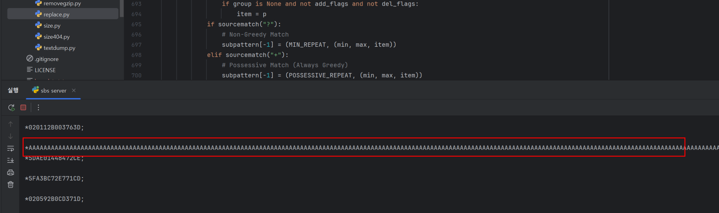
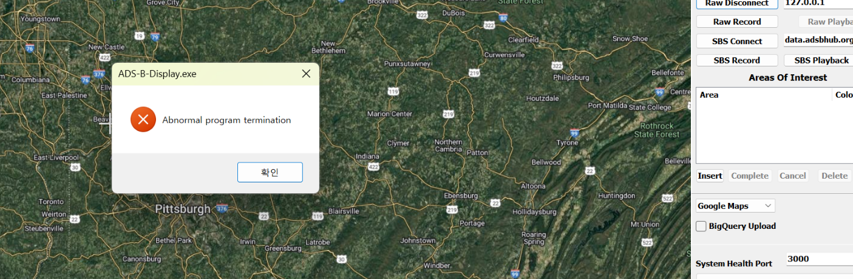
[Appendix] Attack Surfaces : Case 3
Information Disclosure and DoS via Raw Data Tampering on Raspberry Pi
[Appendix] Attack Scenario #AP-1
Attacker intercepts ADS-B data via a TCP proxy and replaces specific patterns like "8D" with a long string of "A"s
With this, we confirmed that the Windows application crashes.
Notes:
In this attack scenario, we use tcpproxy to intercept data sent from the Raspberry Pi in real time. We replace a specific field with a string of 513 ‘A’ characters as the data passes through. Due to a vulnerability in the raw data parsing code, this causes the application to crash, demonstrating how malformed input can trigger critical failures.

Slide 26
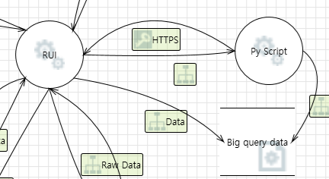
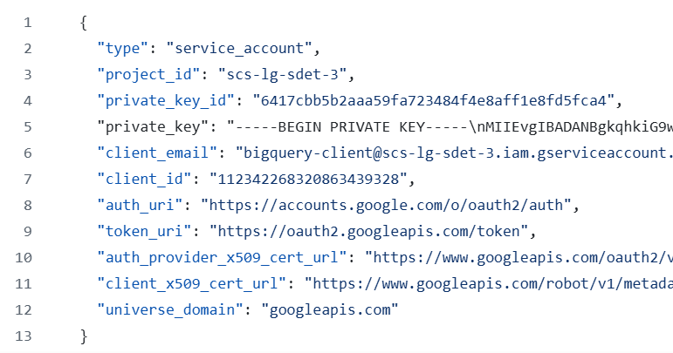
[Appendix] Attack Surfaces : Case 5
RUI <-> Google Bigquery
Security Flaw
Threat
Google BigQuery JSON key file is stored unencrypted,
exposing the private key.
Unauthorized access to and manipulation of
Google BigQuery data.
Attack Vector
An attacker can steal the unencrypted JSON key file and
use it to access and modify data in BigQuery
Notes:
Next, Case 5 is between RUI and BigQuery
This section covers the interaction between the RUI and Google BigQuery.
If someone can access the BigQuery JSON key file stored on the Windows machine, they can read the private key in plain text.
With this key, it is possible to connect to Google BigQuery and both view and modify the stored data.

Slide 27
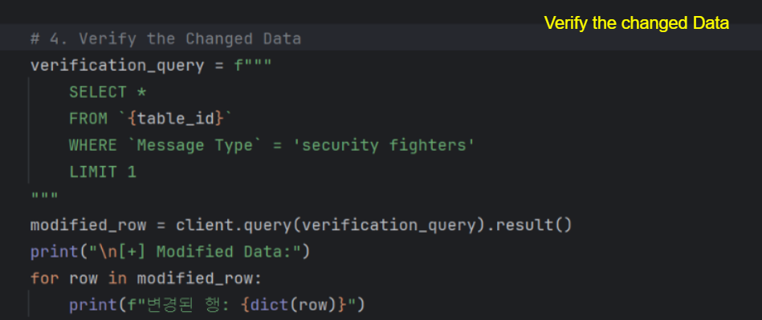
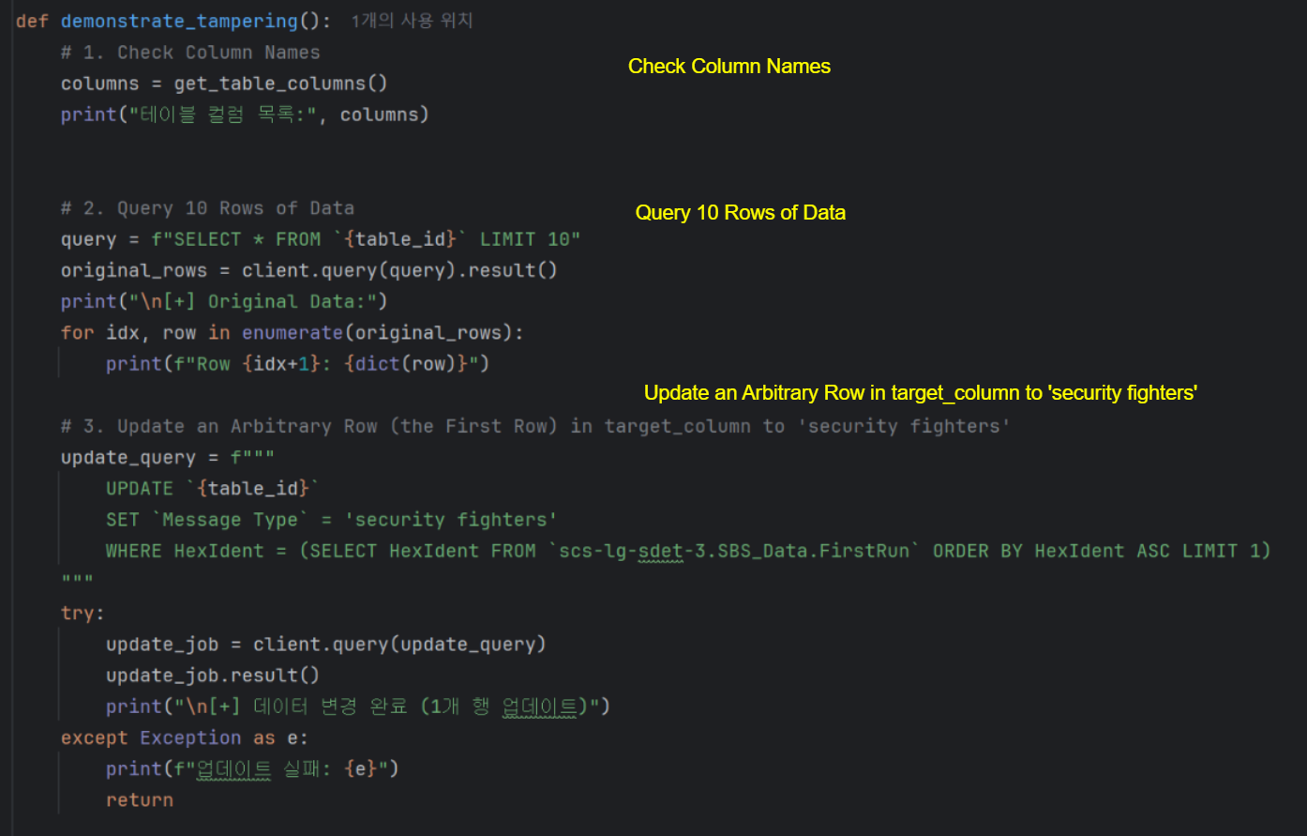
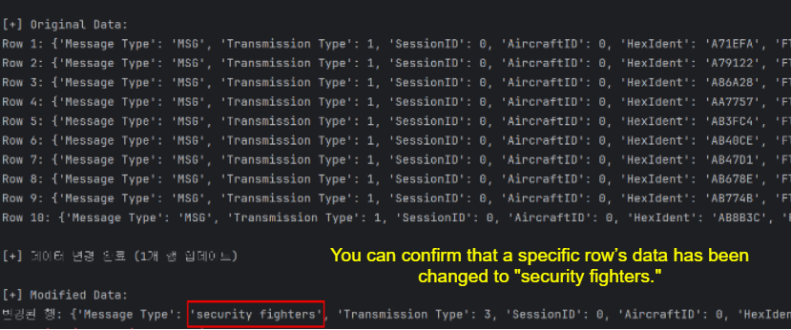
Step 2:
[Appendix] Attack Surfaces : Case 5
The modified data is verified in BigQuery, demonstrating
successful tampering
RUI <-> Google Bigquery
[Appendix] Attack Scenario #AP-2
Precondition :
Attacker gains access
to the unencrypted Google BigQuery JSON key file.
Step 1:
Attacker uses the key to connect to BigQuery, query data, and update
specific rows (e.g., changing "Message Type" to "security fighters").
Result
Notes:
As shown on this screen, you can read the JSON key file and use a simple Python script to access BigQuery.
With this, it’s possible to update any row - for example, changing a specific record’s value to “Security Fighter.”, out team name
This demonstrates how easily data in BigQuery can be manipulated when the key file is exposed.

